Slide 1
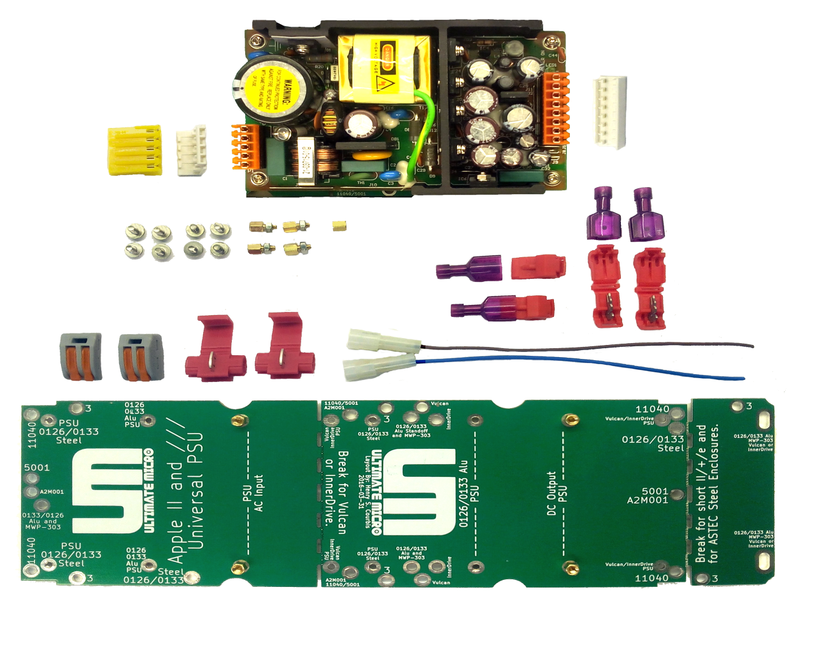
ULTIMATE-MICRO.com Universal PSU Kit
Notes:
Welcome to the UM Universal PSU Kit session.
I’m Henry of ReActiveMicro and we’re going to discuss your Apple II and its Power Supply.
PSU stands for Power Supply Unit.
How and why is it universal? The input AC voltage to the PSU is universal. PCB - It mounts in all Apple II and III metal enclosures.

Slide 2
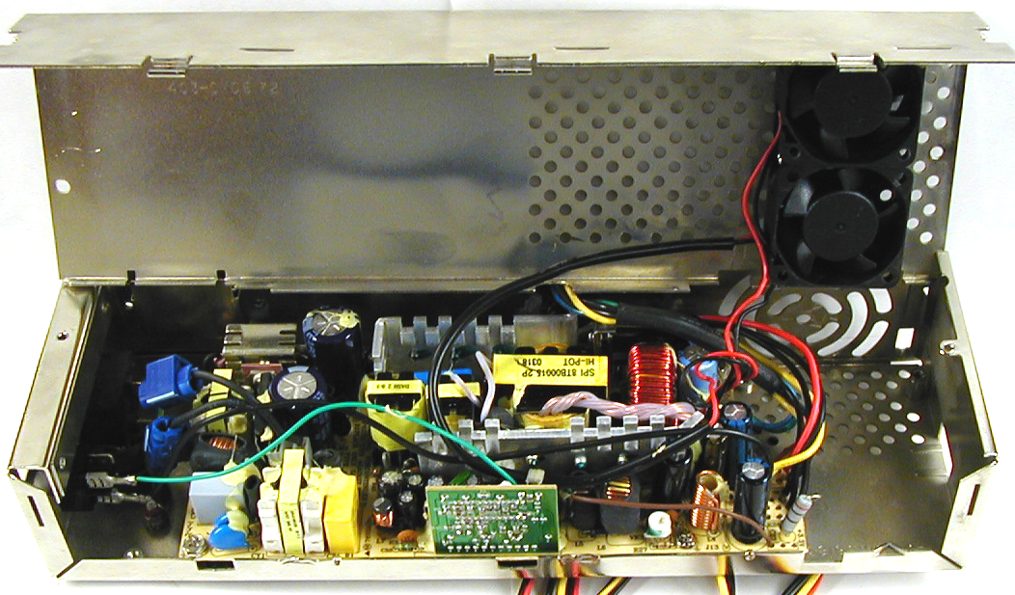
Universal PSU Kit
Background Project Information
Started In 2005
Inconsistencies And Issues With Project Testing
No “Perfect” Solution Was Available
Notes:
***REPEAT QUESTONS FOR CAMERA***
This is an enclosure.
Background project info. Why this year? Started in 2005. As mentioned last KFEST, this was in the works. This allows us a Known Good Starting Point with projects. Lots of inconsistencies with testing. No perfect solution available.

Slide 3
Universal PSU Kit
When Do YOU Need A New Power Supply?
Is It The Original 30+ Year Old
PSU That Came With The Apple?
Notes:
When Do YOU Need A New Power Supply?
A few people recently asked: "How can I tell if I need a new Power Supply for my Apple? After all, my Apple II still works fine."
Good question! Although I actually thought the answer would be obvious.
It is the original, 30+ year old PSU that came with the Apple? Then you need a new one.
How much more do you want or expect from a piece of equipment that was only designed to last a few years at the most?
Do you really believe that Apple designed the Power Supply to last 30+ years?

Slide 4
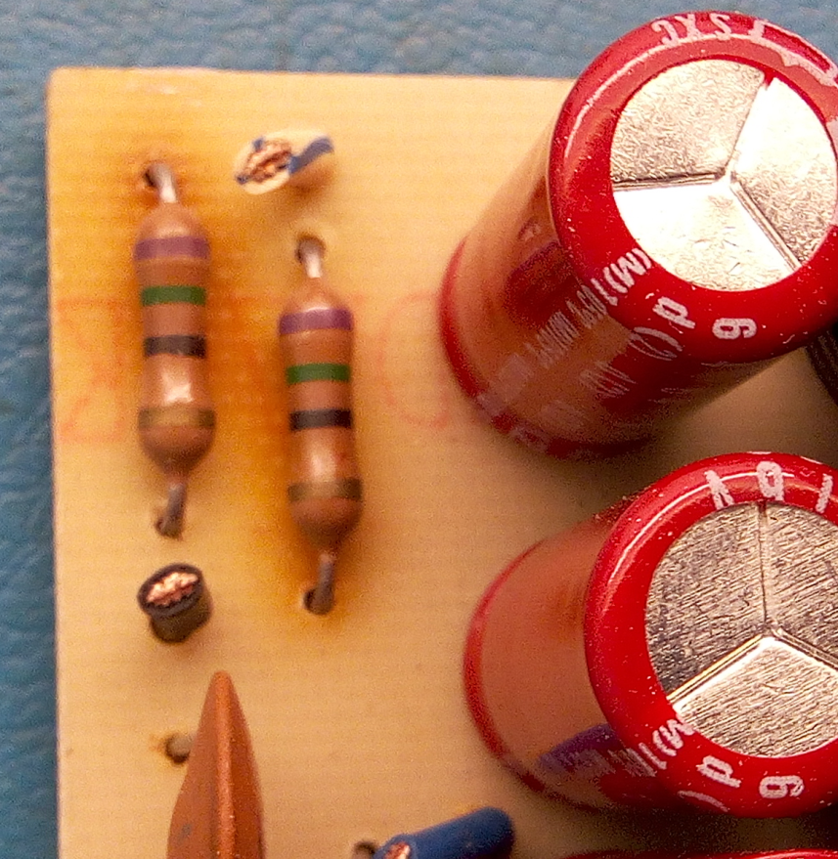
Universal PSU Kit
Rebuild And Capacitor Replacement
Notes:
Replacing caps. Not replacing the parts that are really needed. Diodes and power transistors. Resistors under sized. Gets Hot!

Slide 5
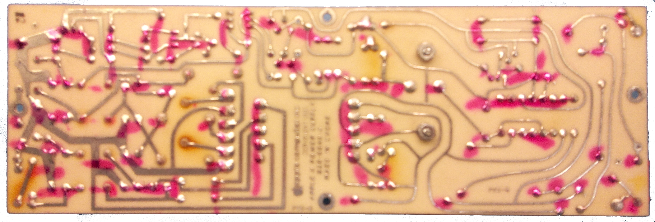
Universal PSU Kit
Rebuild And Capacitor Replacement
Notes:
Regulate and stabilize voltages. Discolor fiberglass. Over-heating parts for 30+ years is fine. 5% tolerance parts WILL CHANGE over time and also with heat.
"But I have recapped my PSU and replaced some critical parts!" This is better of course, but sorry to say you still need a new PSU. At the heart of the PSU is the Step Down Transformer. Did you replace this? We know you couldn't have since they don't make them anymore. And if you did, then it was old stock that also 30 years old. The problem here is the copper wires inside the Transformer are coated with a very thin insulating coating. After years of oxidation and wear of heating up and cooling down cracks form which leads to the Transformer shorting out and usually lots of smoke and even fire. Worse than this however is it can lead to the Transformer outputting voltages far in excess of what they should be.
Most people either don't realize the potential dangers of continuing to use an old PSU or are of the denialist mindset "If it ain't broke, don't fix it." Both can be equally damaging to your beloved Apple II. And when people "max out" their Apple II with lots of peripheral cards this only add more stress to an already tired and worn PSU.

Slide 6
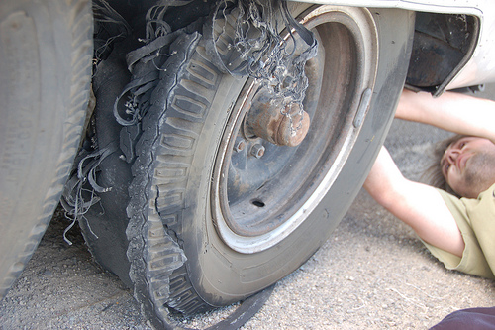
Universal PSU Kit
Be ProActive!
Notes:
Be ProActive! Would you wait for your tire to blow and possibly cause an accident? Or do you replace them when the wear indicator shows? Show of hands who waits till their tires blow out to replace them?
ProActive – Don’t wait for your PSU to fail. It’s 30 years old. How much more do you want from it? When a PSU fails it can cause a lot of damage and take other devises with it.
To help illustrate the problem more clearly we will use your car as an analogy. How often do you replace the tires or change the oil? Do you wait till the tires are so bald and worn that it's impossible to stop in a controllable manner? Do you wait till they go flat? No one does this of course! With your oil, do you change it only when the engine seizes? Doesn't sound like very cost effective solution in the long run or very safe does it?
Those are extreme examples of course, yet people are doing these exact things with their Apple II systems when they don't replace the PSU. The best case scenario is something minor fails and blows out in the old PSU, then it turns itself off. In this case there is usually little if any damage to your Apple II and peripherals. This unfortunately isn't always so. Since we can't tell which part just failed, perhaps 100v was just sent through your Apple II for a few milliseconds. Not enough to cause a fire or show physically apparent damage. However a few DRAM and a couple custom Apple ICs suffered from the experience and will now will work unreliably and fail much sooner than they would have otherwise. And your Apple II may "work fine" for month after and not show any symptoms.
The simplest Apple II PSU has over 50 parts. Most have much more than that - any of which could fail due to age alone. Something as simple as a capacitor could fail, which can lead to unregulated voltages or unfiltered noise which can cause major issues. Worst case a more major component fails which will lead to shorts, fires, along with motherboards and their peripherals destroyed beyond repair. We receive several emails a year from users asking us to fix just such systems and cards. Unfortunately there is little hope to resurrect such damaged boards, especially when their copper traces have been turned to smoke or holes are burned through the PCB.

Slide 7
Universal PSU Kit
Pitfalls Of ATX
Original PSU Upgrade Was ATX IOmin Values
3.3v Output Unused
Notes:
Pitfalls of using ATX. Original PSU Upgrade from 2005 Was ATX IOmin Values – Manufacture requirement Min Loads (Amps) 3.3v Output Unused
Not meeting the IOmin values can cause something as simple as reduced power or voltage regulation or even the PSU not turning on. It can also lead to things a lot worse – such as wild swings in output voltages far beyond what is normal.
Issues can and will be inconsistent.
Issues are affected by temperatures, humidly, AC input power or voltage, and loads.
When using an ATX – took readings - When is it “good”? For 5 seconds when you took the measurement? Did you monitor it for 10 mins, an hour, or longer? What kind of loading in your Apple?
Issues will happen and are intermittent with ATX. They change with load, heat, how clean input power is, and even humidity.

Slide 8
Universal PSU Kit
Average Apple Uses 15 Watts
Notes:
The Apple II is like the Buggy: Dependable, easy to repair, low cost, easy to understand and add to.
The PSU it requires is only a small work animal, like mule or horse.

Slide 9
Universal PSU Kit
Average ATX Power Supply Is 100-300 Watts
Notes:
Average ATX Power Supply Is 100-300 Watts
Could you add a Rocket Engine with After Burners to the Buggy? Sure, however we start run in to some new issues: When is “too much” too much? Best is to match the tool to the job. You don’t want to use a chain saw to widdle a toothpick. Nor do you want to use a pen knife to cut down a 200 year old oak tree.

Slide 10
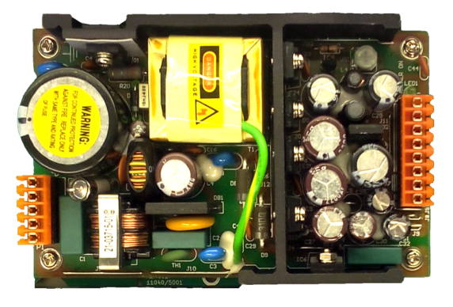
Universal PSU Kit
Universal Power Supply Is 63 Watts
Notes:
Universal Power Supply Is 63 Watts
Major difference than Apple II PSU – it’s 30+ years newer design: Modern Design – last long. Less heat. Better protection. Insanely easy to install. Takes about 15 mins. No modifications to Enclosure or Chassis needed.
Good for AT LEAST another 10 years of use. That’s $10 a year for peace of mind. These are “Medical Grade” PSUs. 10 year old track record. Rev “Q”.

Slide 11
Thanks!
John Morris Chris Torrence Joe Strosnider David Ramsey Herbert Fung Everyone Who Donated Equipment Everyone I Forgot To List Apple II Community - Woz
KFEST Committee For Their Time And Efforts To Make KFEST Happen!
Notes:
In Closing: Everyone NEEDS to replace their PSU. You should do so every 10 years or sooner.
John Morris Chris Torrence Joe Strosnider David Ramsey Herbert Fung Everyone Who Donated Equipment Everyone I Forgot To List Apple II Community - Woz

